Slide 1
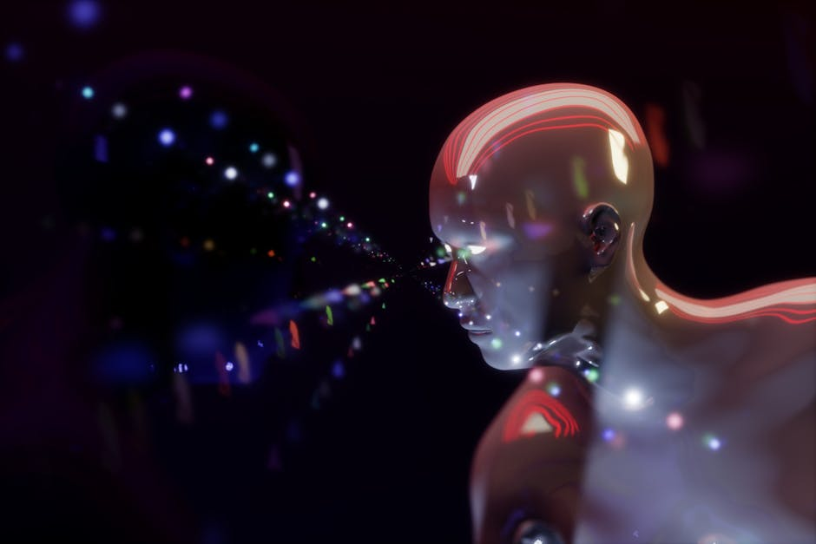
Disease Predictor using ML algorithms
BY
KORADA VIJAYA ANJALI
ADITYA UNIVERSITY
21A91A6148

Slide 2
INDEX
INTRODUCTION
TECHNOLOGIES USED
WHY MACHINE LEARNING
METHODOLOGY
DEPLOYMENT
RESULTS
CONCLUSION

Slide 3
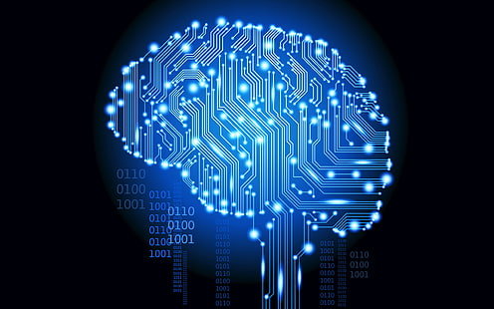
01. Introduction
My project is about disease prediction using machine learning algorithms. In today's world, the ability to accurately predict diseases can significantly enhance healthcare outcomes and improve patient care.
My project leverages the power of machine learning to create predictive models that can identify potential health issues before they become critical.

Slide 4
02.Technologies Used
Pycharm
Tkinter
Numpy
Pandas
Scikit-learn
Machine Learning Algorithms
Decision Tree
Random Forest
Naive Bayes
Kaggle & Hugging Face

Slide 5
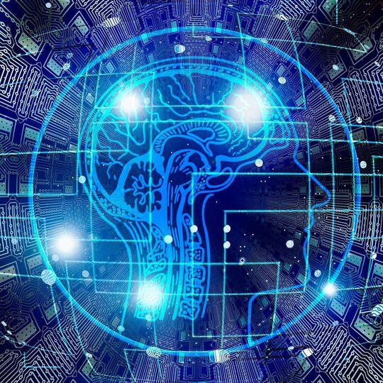
03. Why Machine Learning
Machine learning offers several advantages they are:
High Accuracy rate, Handling Large Volumes of Data, Efficiency, Precision, Scalability, Continuous Improvement, Uncovering Hidden Patterns, Predictive Analytics.
ML Algorithms:
Decision Tree: A decision tree is a model that uses a tree-like graph of decisions and their possible consequences to classify or predict outcomes based on input features.
Random Forest: A random forest is an ensemble learning method that constructs multiple decision trees during training and outputs the mode of the classes (classification) or mean prediction (regression) of the individual trees.
Naive Bayes: Naive Bayes is a probabilistic classifier based on Bayes' theorem, assuming strong (naive) independence between features, used for classification tasks.

Slide 6
04. Methodology
Data Collection: I gathered extensive patient data, including medical histories, from the kaggle and hugging face websites.
Data Preprocessing: The data was cleaned and preprocessed to ensure accuracy and completeness. This step included handling missing values, normalization, and feature selection.
Model Development: We developed and trained multiple machine learning models using algorithms such as Decision Tree, Random Forest, and Naive Bayes.
Model Evaluation: The models were evaluated based on their accuracy, precision, recall, and other relevant metrics to determine their effectiveness in predicting diseases.
Deployment: The best-performing models were selected for deployment in a user-friendly interface, allowing healthcare professionals to input patient data and receive predictive insights.

Slide 7


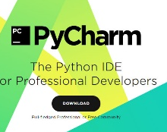

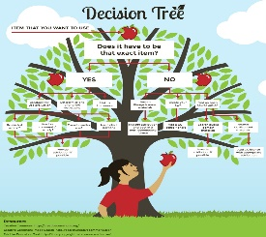
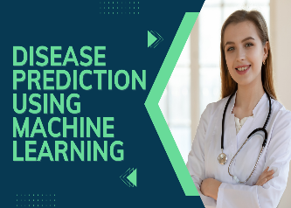

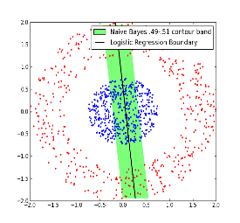
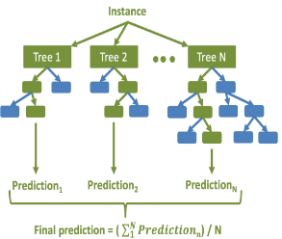
05. Development

Slide 8
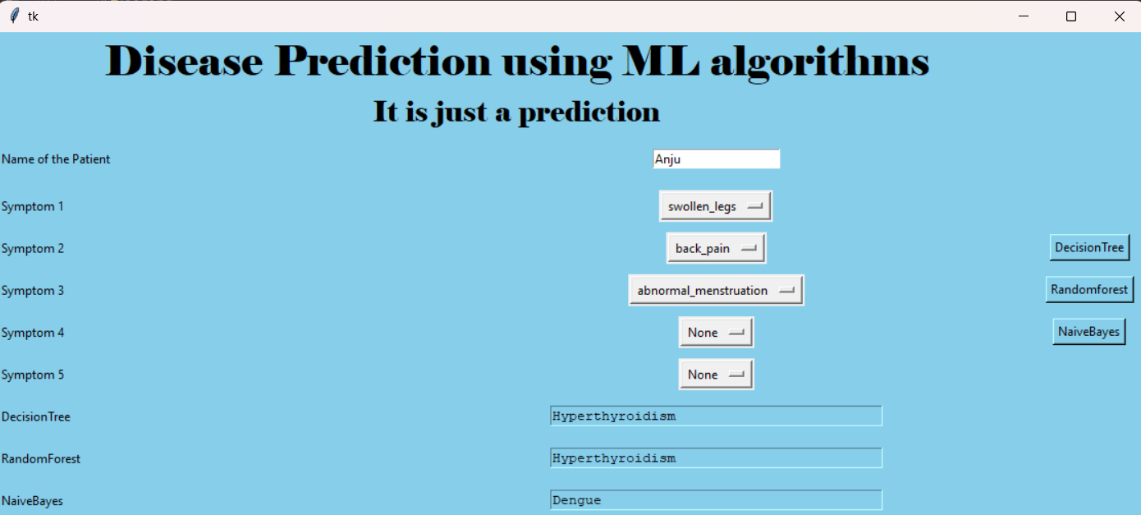
06.Results

Slide 9
07. CONCLUSION
In conclusion, my project demonstrates the transformative potential of machine learning in the healthcare sector. By harnessing these advanced technologies, we can make significant strides towards better health outcomes and a more efficient healthcare system.
Improve Early Detection: By predicting diseases at an early stage, healthcare providers can intervene sooner, potentially saving lives and reducing treatment costs.
Personalize Treatment: Predictions can help tailor treatments to individual patients based on their unique risk factors and medical history.
Enhance Healthcare Efficiency: Automating the prediction process frees up valuable time for healthcare professionals, allowing them to focus on patient care.

Slide 10


